Slide 1
Confocal Non-Line-of-Sight Imaging
Group 2
Caio Da Silva, Palak Dave, Hunter Morera, & Daniel Sawyer

Slide 2
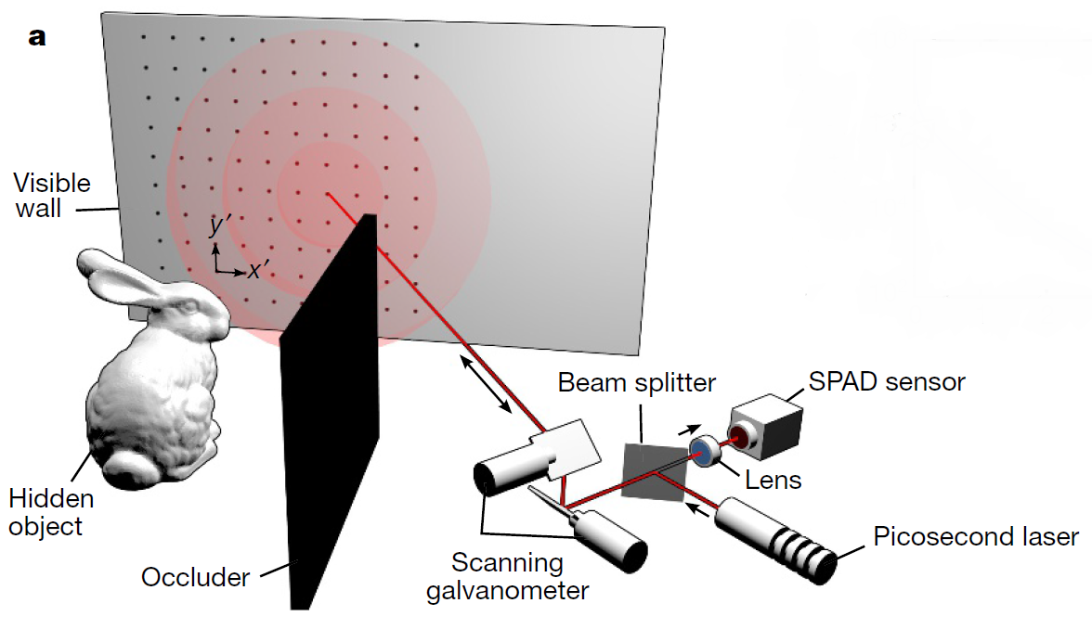
What Is Confocal Non-Line-of-Sight Imaging?
Confocal Non-Line-of-Sight (NLOS) is a method to view objects that are completely occluded.
Uses surrounding objects as diffuse reflectors in order to illuminate object.
Reconstructs objects from multiply scattered light.

Slide 3
Why Should We Care & What It’s Good For?
There are many uses for viewing and tracking objects fully occluded.
Reduction on complexity along with reduced memory requirements.
Deals with extremely weak signal of multiply scattered light better than existing reconstruction algorithms.
Works in the outdoors under indirect sunlight.

Slide 4
Why Should We Care & What It’s Good For?
Practical Applications:
Robotic Vision Systems
Remote Sensing Vision and Recognition Systems
Autonomous Vehicles Vision and Detection Systems
Medical Imaging
Tracking Objects in Vision Systems

Slide 5
Why Should We Care & What It’s Good For?
Robotic Vision System:
Can locate and identify objects which are fully occluded.
Allows for a much more robust human-assistive robotics vision system.
Real-world applications require this in order to acquire human-level accuracy for similar scenarios in robotic assistance.

Slide 6
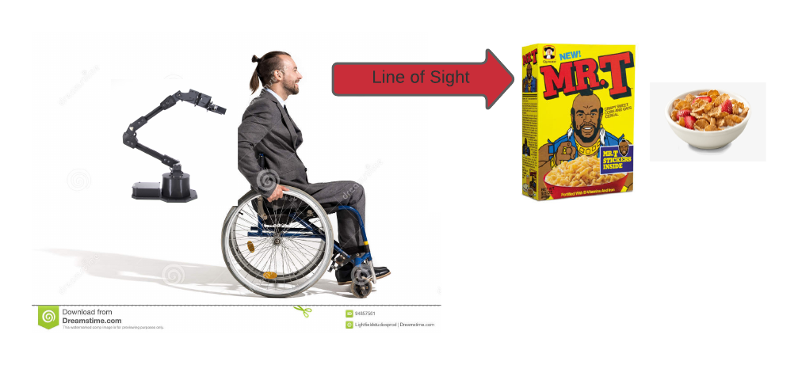
Why Should We Care & What It’s Good For?
Robotic Vision System: Wheelchair Mounted Robotic Arm (WMRA) for human-assistive robotics.
Mr. T pities the fool who can’t reconstruct fully occluded objects ☺

Slide 7
Why Should We Care & What It’s Good For?
Remote Sensing:
Allow recognition of different types of vehicles.
Allow you to identify buildings from top-down view.
Differentiate between what the buildings actually are from top-down view.
Reconstruct semi-occluded objects over a temporal window?

Slide 8
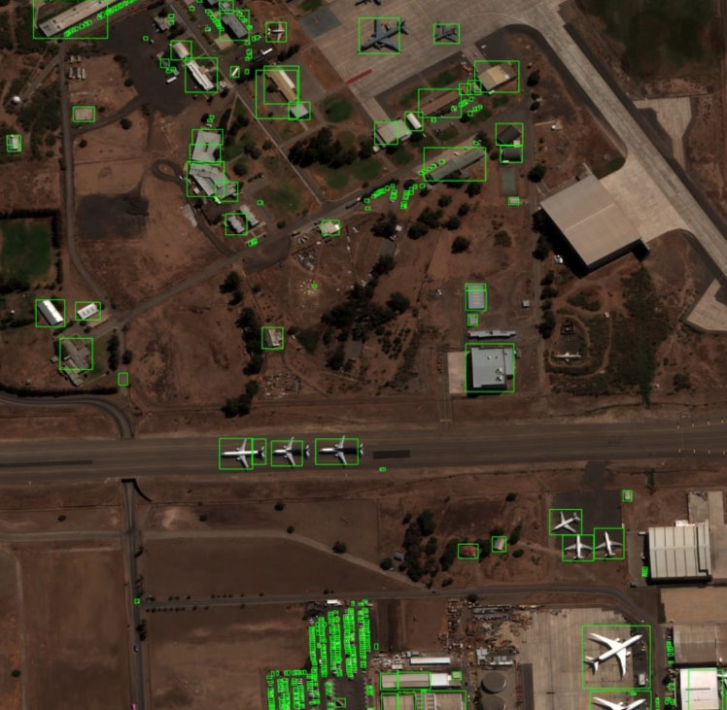
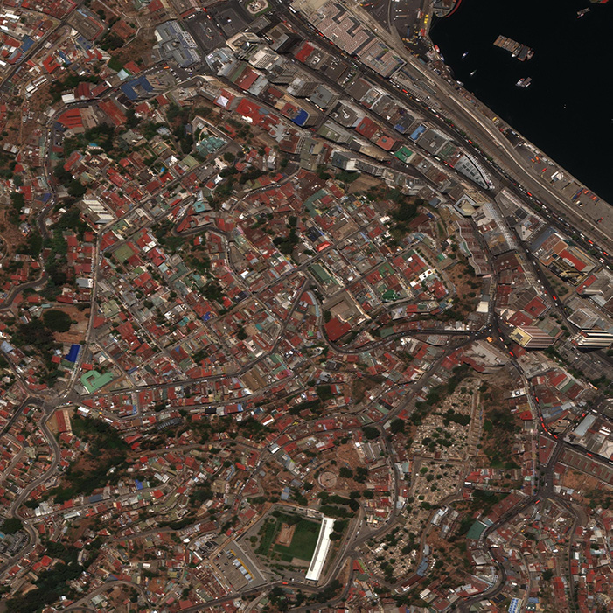
Why Should We Care & What It’s Good For?
Remote Sensing: Identifying buildings from top-view satellite images.

Slide 9
Why Should We Care & What It’s Good For?
Autonomous Vehicles :
Allows you to image vehicles in front of you that are fully occluded.
Allows you to image vehicles behind you that are fully occluded.
Can see occluded pedestrians to prevent accidents.
Gives better overall awareness to the autonomous driving system allowing for a safer and more robust autonomous driving system.

Slide 10
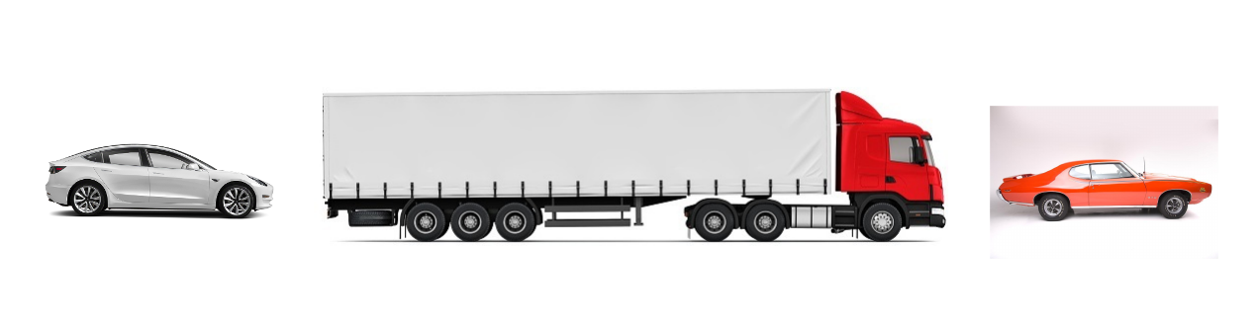
Why Should We Care & What It’s Good For?
Autonomous Vehicles: Reconstructing fully occluded vehicles.

Slide 11
Why Should We Care & What It’s Good For?
Object Tracking:
Object tracking in the real-world almost always has some form of occlusion.
Allows a more robust vision system for tracking rather than using techniques like Kalman filter.
Can give more robust and accurate results of object location than other methods.

Slide 12
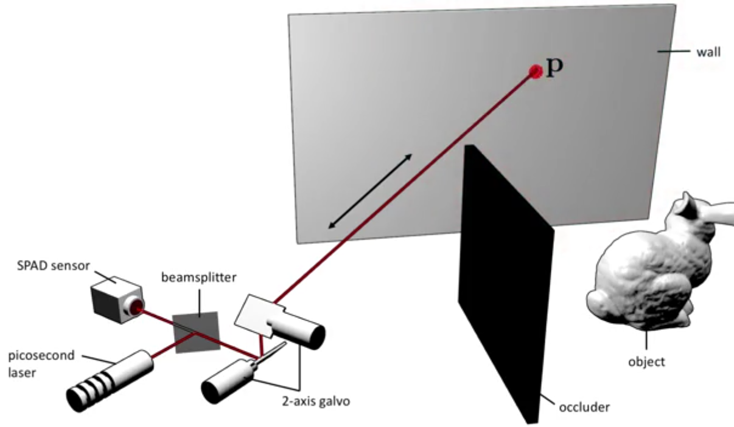
Imaging System Setup
The imaging system is not anything novel.
Similar to LIDAR but uses multiply scattered light instead of direct reflections.
Contains beam splitter, Single-photon avalanche diode (SPAD) sensor, a lens, picosecond laser, and scanning galvanometer.

Slide 13
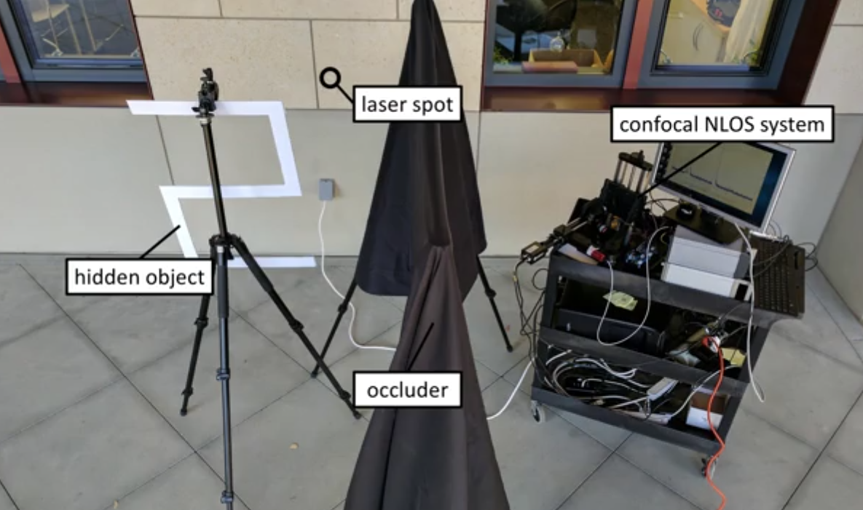
Imaging System Setup
Real World Setup:

Slide 14
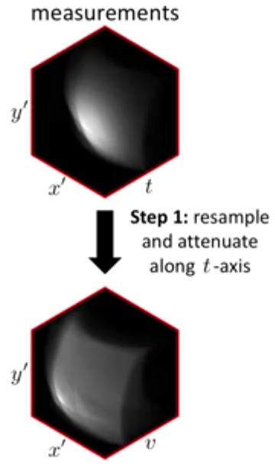
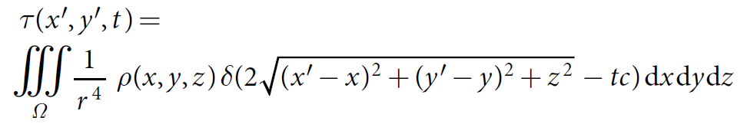
How Does It Work?
Step 1: Collect measurements, resample, and attenuate along the temporal axis t using a 2D set of temporal histograms.

Slide 15
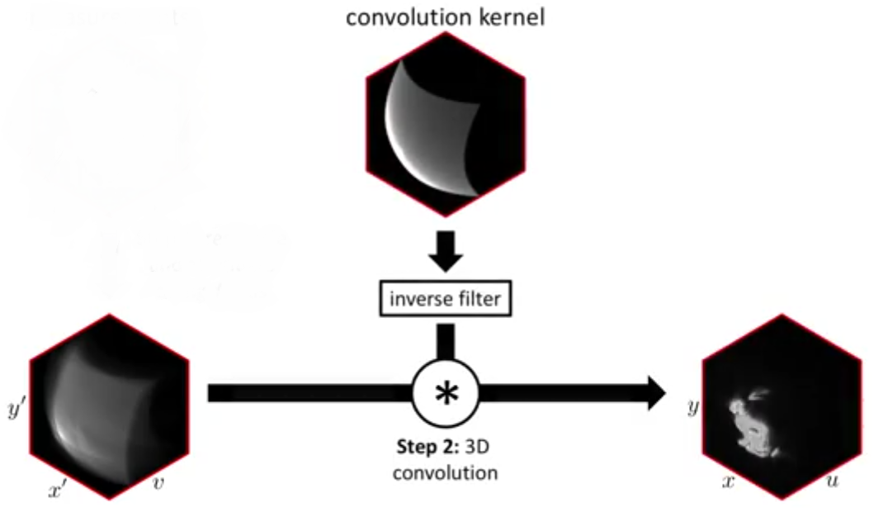
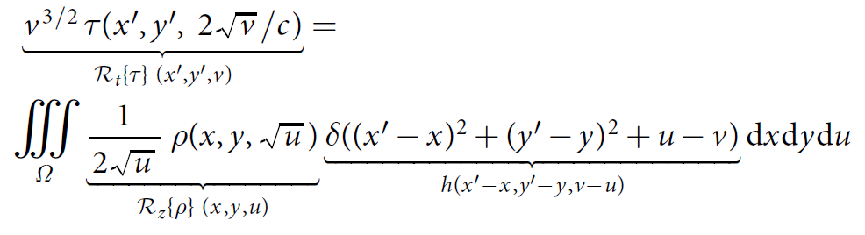
How Does It Work?
Step 2: 3D convolution using the convolutional kernel, inverse filter, and measurements. The first equation allows for change in variable z (depth) which can be expressed as a straightforward 3D convolution that’s shift invariant.

Slide 16
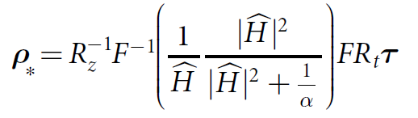
How Does It Work?
Step 2: Treating as a spatially invariant 3D deconvolution we can derive this as an element-wise multiplication in the Fourier domain and inverted. Based on Wiener filtering, which minimizes the mean squared error between reconstruction and GT.

Slide 17
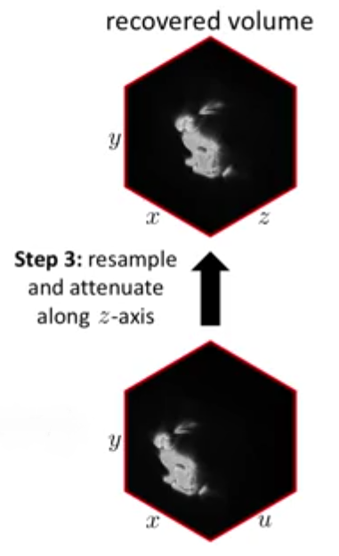
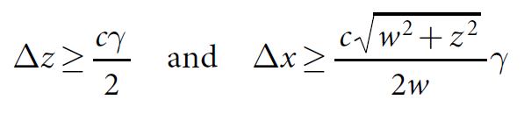
How Does It Work?
Step 3: Using it outdoors with indirect sunlight requires resampling in order to increase resolution/detail. The fundamental bounds on resolution of NLOS are full-width and half-max temporal resolution of the imaging system and scaled along the z (depth/distance) axis. So it’s dependent on hardware ability.

Slide 18

How Does It Work?

Slide 19
How Does It Work?

Slide 20
Implementation & Modifications
We implemented using both Matlab and Python/NumPy but our results for this and the report are from Matlab.
Used base code and rewrote trying to improve complexity performance (cleaning up code) and resolution/feature/texture performance by adding pre and post processing Gaussian methods.

Slide 21
Implementation & Modifications
We could modify this using Deep Learning methods in order to improve accuracy and resolution.
Using a combination of Temporal Convolutional Networks (TCN) along with Generative Adversarial Networks (GAN) we should be able to reconstruct the occluded objects with better accuracy and higher, more realistic resolution and even maybe color.
It would also increase speed so it could be used in the real world as TCNs can easily do faster than real-time inference (350Hz for action recognition on videos).
This will have to be fully-supervised though and require an annotated ground truth, which isn’t easy to create.

Slide 22
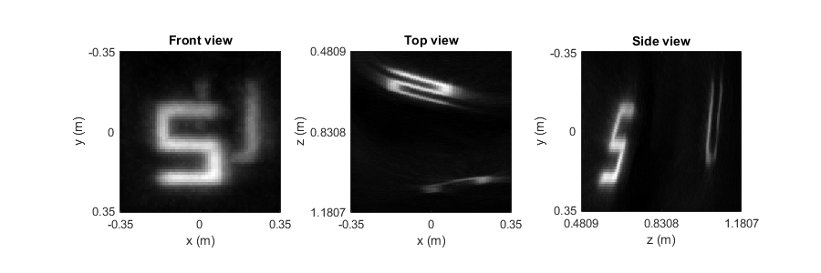
Results: Indoors

Slide 23
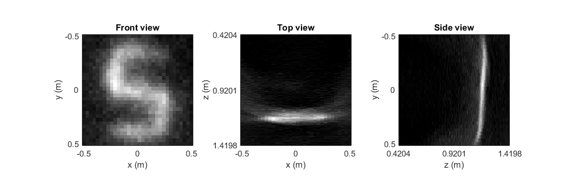
Results: Outdoors

Slide 24
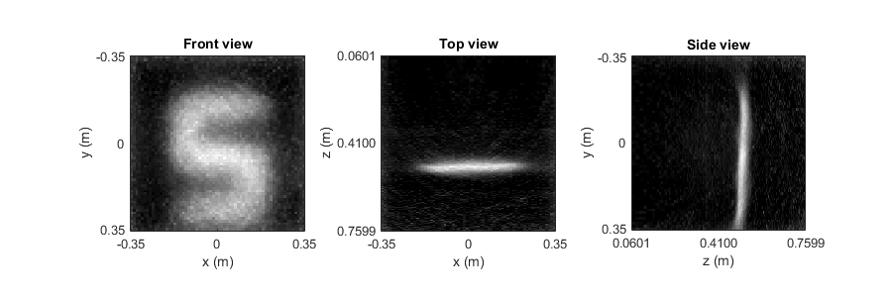
Results: Diffuse

Slide 25
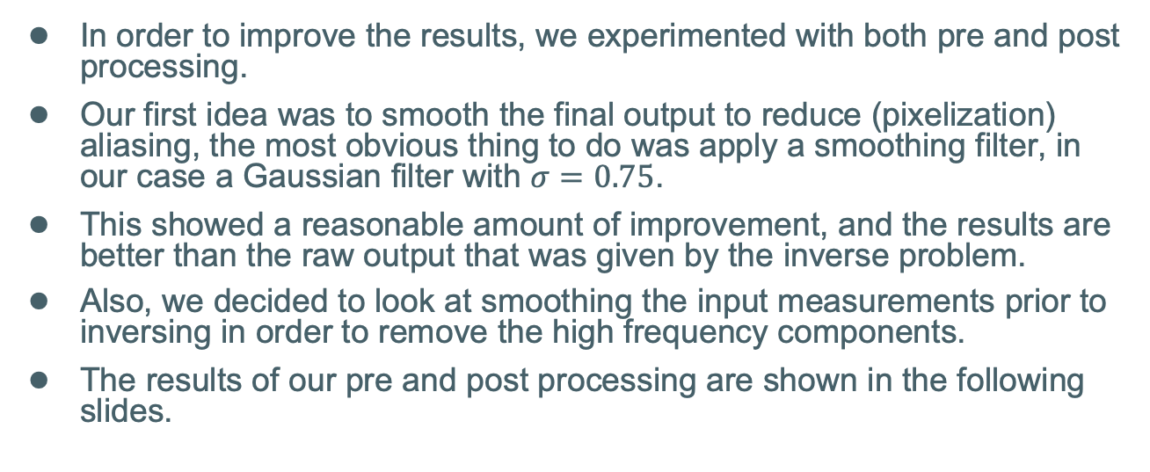
Filtering Modifications
In order to improve the results, we experimented with both pre and post processing.
Our first idea was to smooth the final output to reduce (pixelization) aliasing, the most obvious thing to do was apply a smoothing filter, in our case a Gaussian filter with $σ=0.75$.
This showed a reasonable amount of improvement, and the results are better than the raw output that was given by the inverse problem.
Also, we decided to look at smoothing the input measurements prior to inversing in order to remove the high frequency components.
The results of our pre and post processing are shown in the following slides.

Slide 26
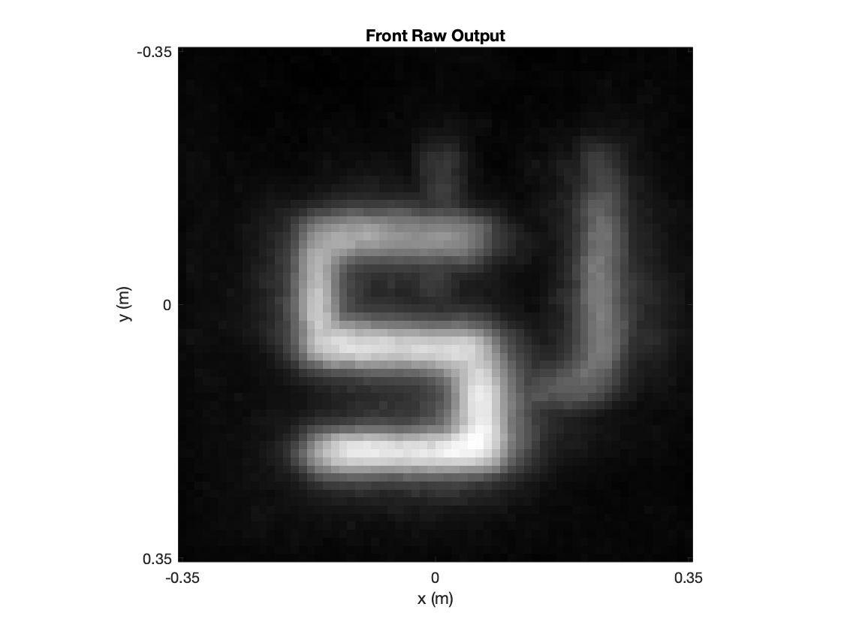
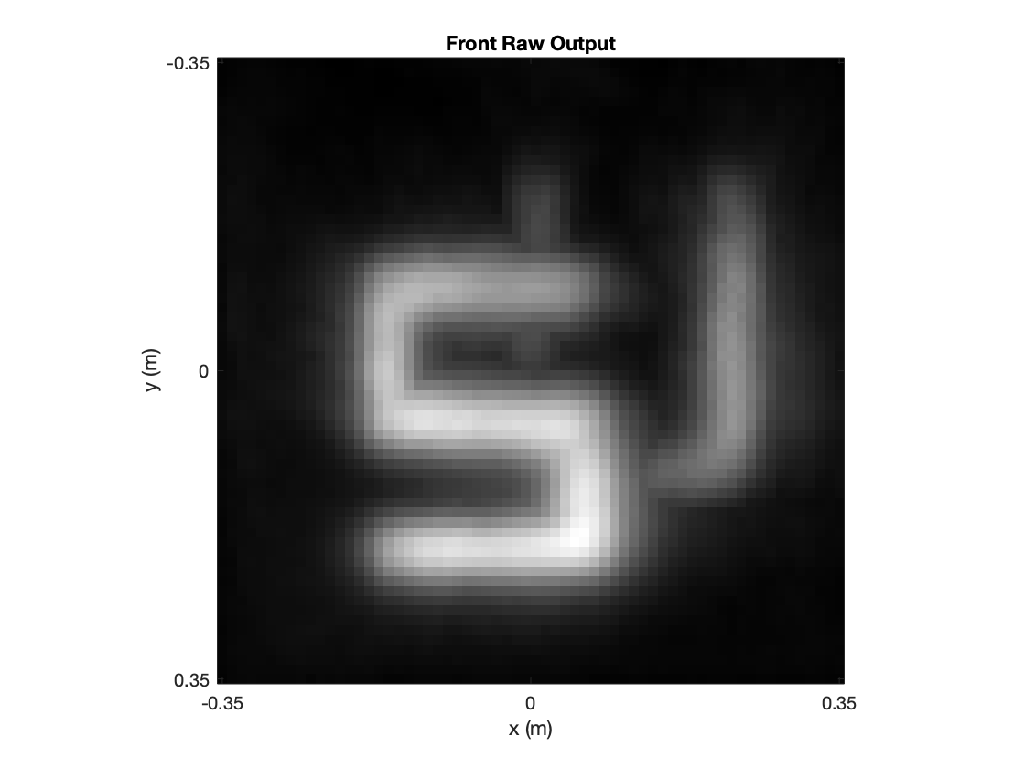
Results: Indoors Gaussian Pre Processing
Raw Output
Post-Processing

Slide 27
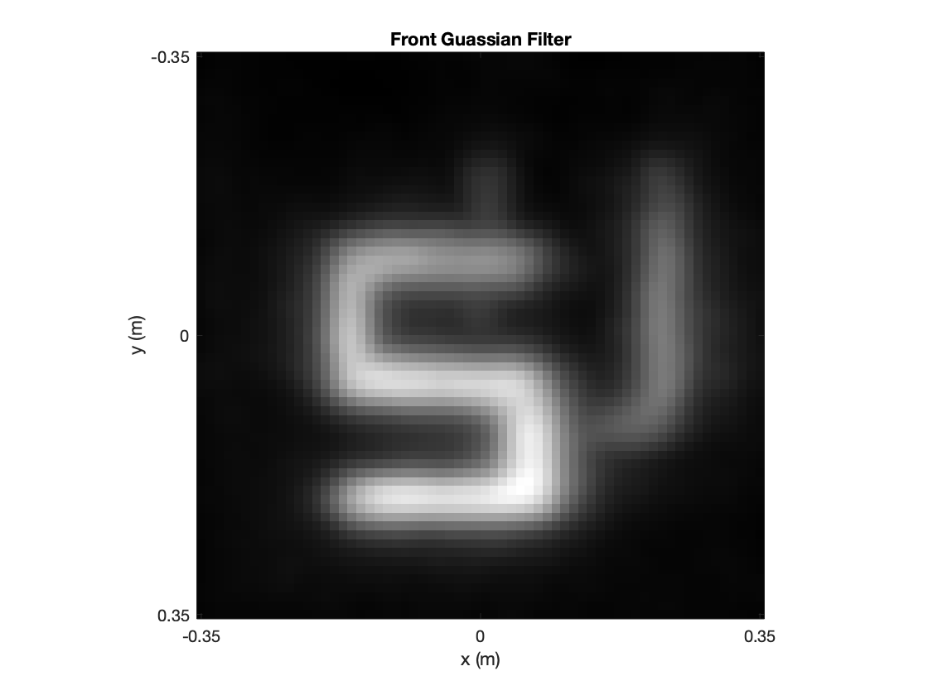
Results: Indoors Gaussian Post Processing
Raw Output
Post-Processing

Slide 28
Result: Indoor Pre vs Post Processing
Pre-Processing
Post-Processing

Slide 29
Modifications to SNR & Temporal Bins
We experimented with changing the SNR values and temporal bin resolution that was in the original code.
The default SNR value was 0.8, as we increased the SNR value, we found that the image quality is reduced.
In order to increase the speed of computation the original authors are downsampling the temporal resolution by a factor of 2. We also tried manipulating this value to see if we achieve better results without this downsampling.
The elimination of downsampling does increase the time to run the code, the results of the following modifications are in the next slides.

Slide 30

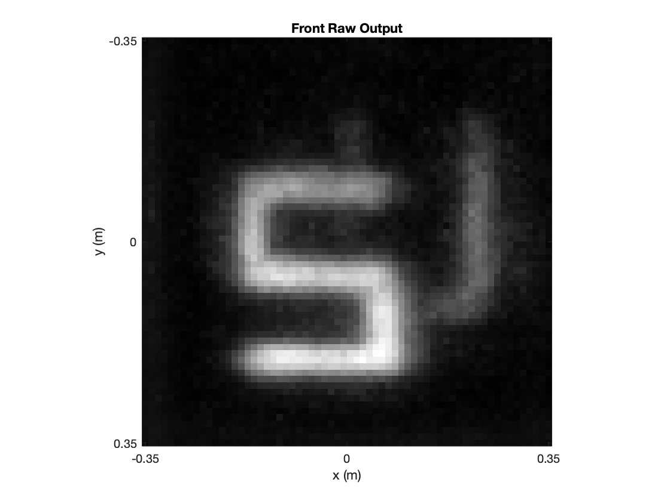
SNR Modification
SNR = 0.8
SNR = 5
SNR = 10

Slide 31

Downsampling Modification
Downsample by 2
No Downsampling

Slide 32
How To Improve?
We could modify this using Deep Learning methods in order to improve accuracy and resolution.
Using a combination of Temporal Convolutional Networks (TCN) along with Generative Adversarial Networks (GAN) we should be able to reconstruct the occluded objects with better accuracy and higher, more realistic resolution and even maybe color.
It would also increase speed so it could be used in the real world as TCNs can easily do faster than real-time inference (350Hz for action recognition on videos).
This will have to be fully-supervised though and require an annotated ground truth, which isn’t easy to create.

Slide 33
References
Original Nature Paper: https://www.nature.com/articles/nature25489/
Supplementary Information: https://static-content.springer.com/esm/art%3A10.1038%2Fnature25489/MediaObjects/41586_2018_BFnature25489_MOESM1_ESM.pdf
Code and data: https://static-content.springer.com/esm/art%3A10.1038%2Fnature25489/MediaObjects/41586_2018_BFnature25489_MOESM2_ESM.zip
Our code GitHub: https://github.com/sawyermade/comp_img_final_project

Slide 34
Questions?

